Slide 1
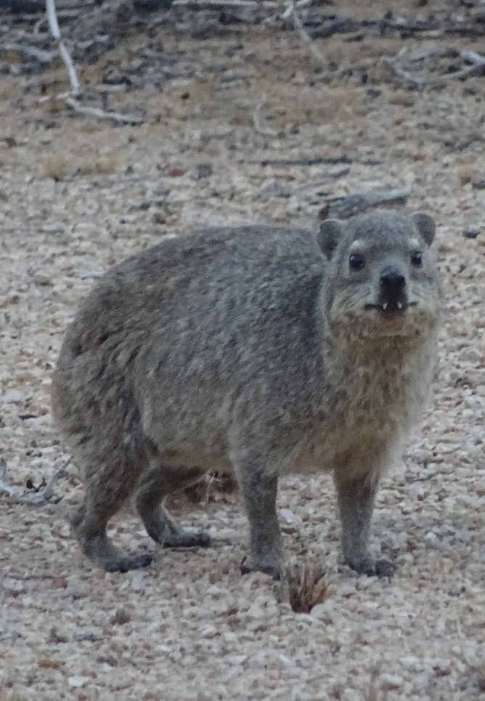
Stage based matrix models

Slide 2
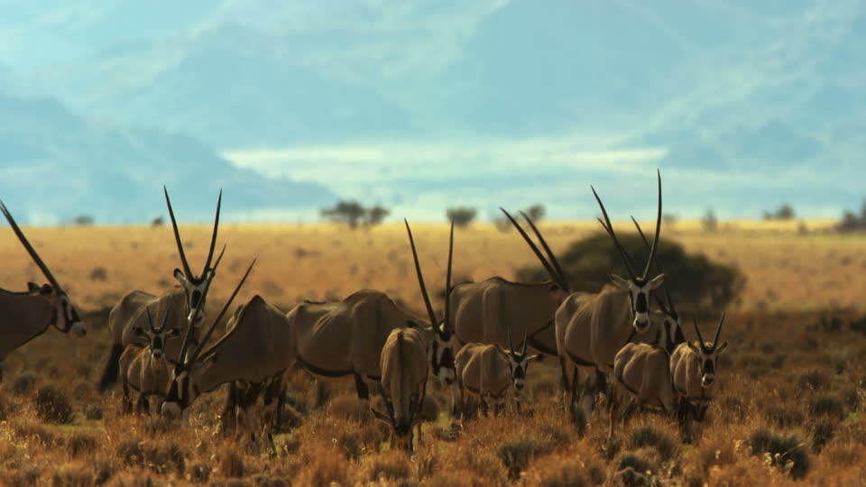
Why not always use age based matrix models?

Slide 3
It can be hard to know the exact age of animals
Unless you capture an animal when it’s born
Determining the age can be hard
Options include, e.g., using dental rings
An easier option is to assign the stage of an animal
Can be based on, weight, ornamentation, general appearance, etc.

Slide 4
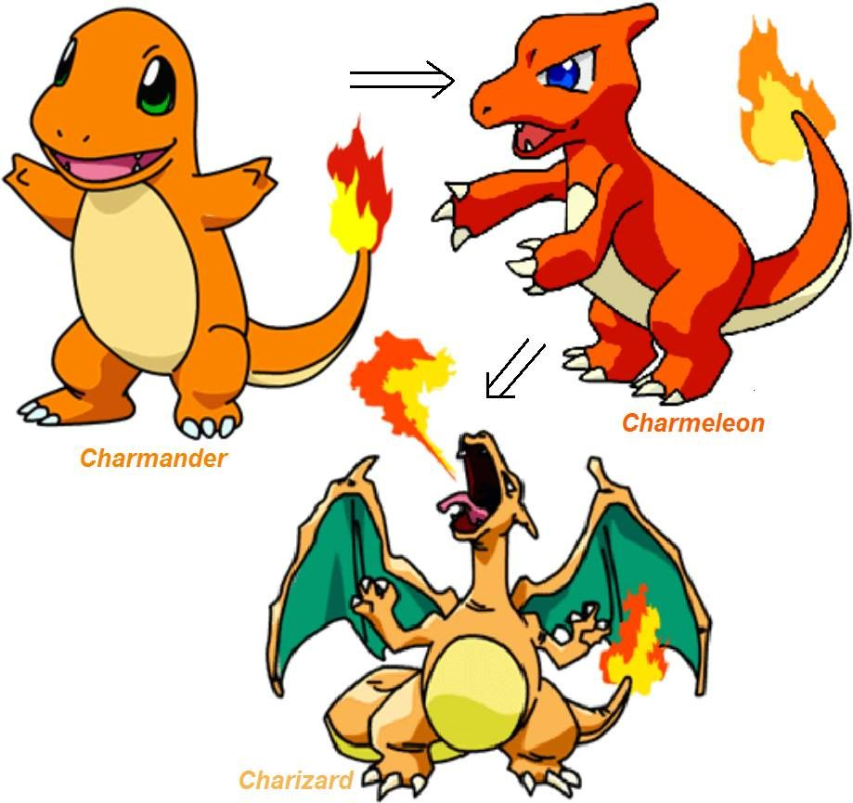
Classing animals by stage
We assume that members of the same class will be similar
Not as specific as age, but a good compromise in many cases
Labels given to stages can be arbitrary
Yearling, juvenile, adult
Juvenile, sub-adult, adult
Baby, toddler, pensioner
Needs a probability for animal to transition to next stage

Slide 5
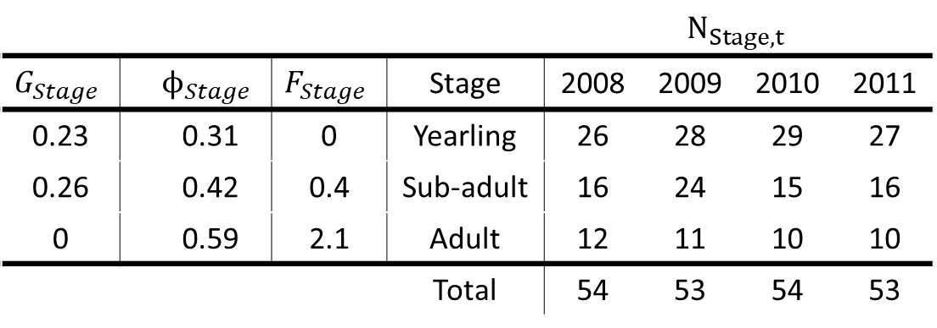
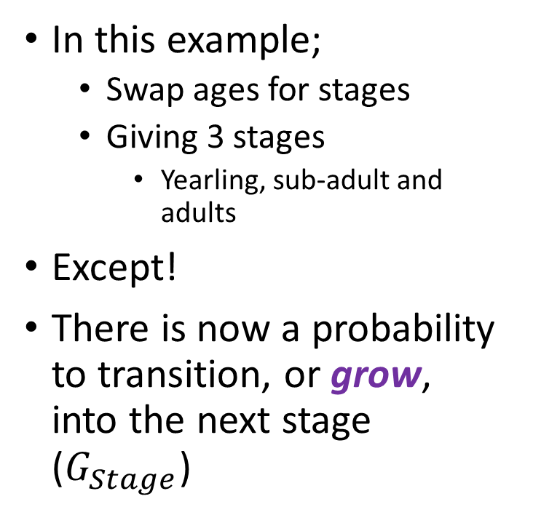
Initially, stage models are similar to age models
In this example;
Swap ages for stages
Giving 3 stages
Yearling, sub-adult and adults
Except!
There is now a probability to transition, or grow, into the next stage ($G_{Stage}$)
 |  |  |  |  | $$N_{Stage,t}$$
$$G_{Stage}$$ |  | $$ϕ_{Stage}$$ | $$F_{Stage}$$ | Stage | 2008 | 2009 | 2010 | 2011
0.23 |  | 0.31 | 0 | Yearling | 26 | 28 | 29 | 27
0.26 |  | 0.42 | 0.4 | Sub-adult | 16 | 24 | 15 | 16
0 |  | 0.59 | 2.1 | Adult | 12 | 11 | 10 | 10
 |  |  |  | Total | 54 | 53 | 54 | 53

Slide 6
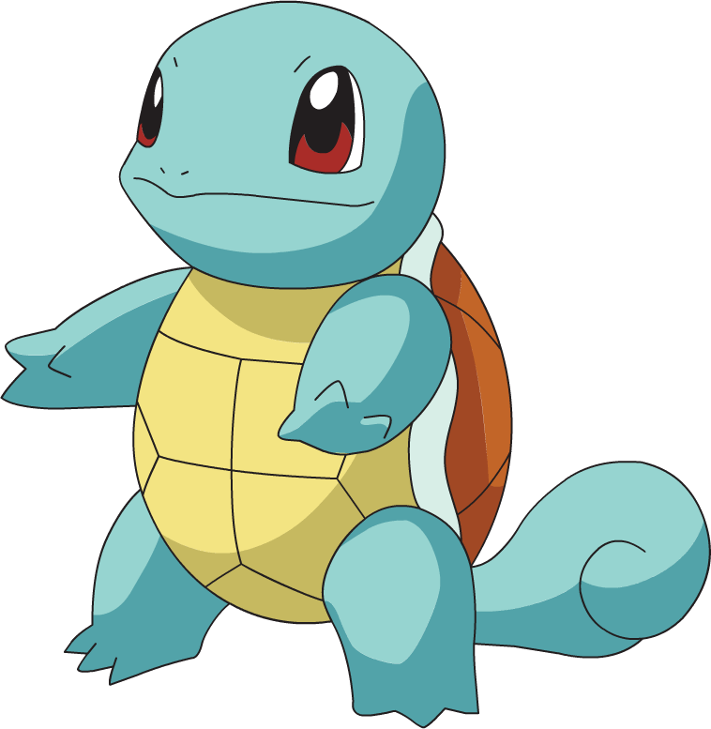



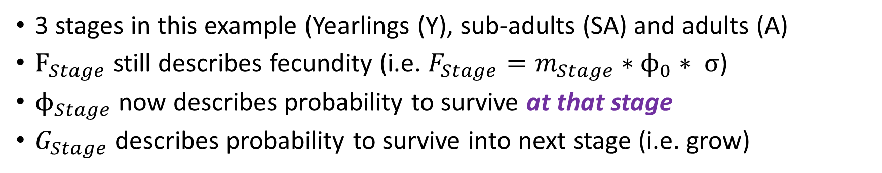




Stage based life histories
3 stages in this example (Yearlings (Y), sub-adults (SA) and adults (A)
$F_{Stage}$ still describes fecundity (i.e. $F_{Stage}=m_{Stage}∗ϕ_{0}∗ σ$)
$ϕ_{Stage}$ now describes probability to survive at that stage
$G_{Stage}$ describes probability to survive into next stage (i.e. grow)
$$F_{SA}$$
$$F_{A}$$
Y
SA
A
$$G_{Y}$$
$$G_{SA}$$
$$ϕ_{Y}$$
$$ϕ_{SA}$$
$$ϕ_{A}$$

Slide 7
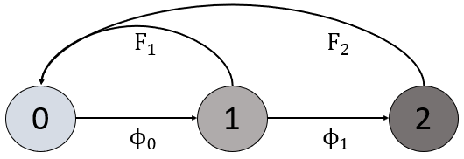
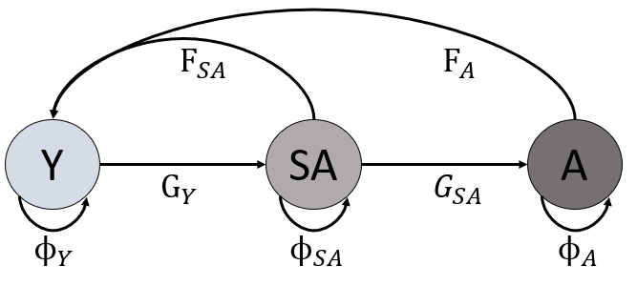
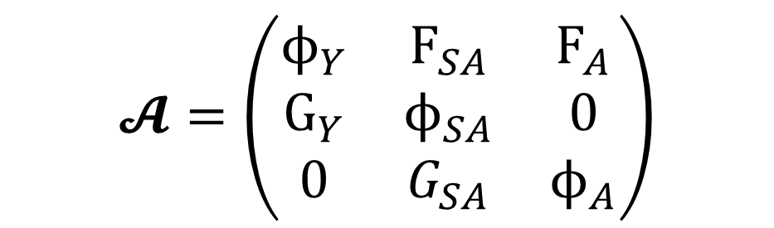
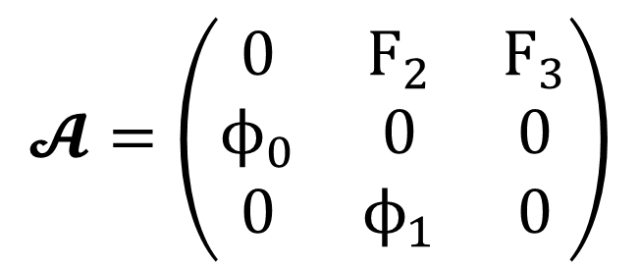
Stage based life history as a matrix
Age based life history
Stage based life history
$$𝓐=\left(\begin{matrix}0 & F_{2} & F_{3} \\ ϕ_{0} & 0 & 0 \\ 0 & ϕ_{1} & 0\end{matrix}\right)$$
$$𝓐=\left(\begin{matrix}ϕ_{Y} & F_{SA} & F_{A} \\ G_{Y} & ϕ_{SA} & 0 \\ 0 & G_{SA} & ϕ_{A}\end{matrix}\right)$$

Slide 8
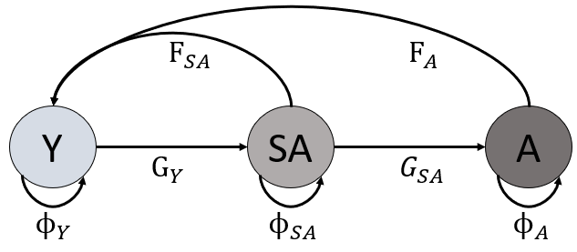
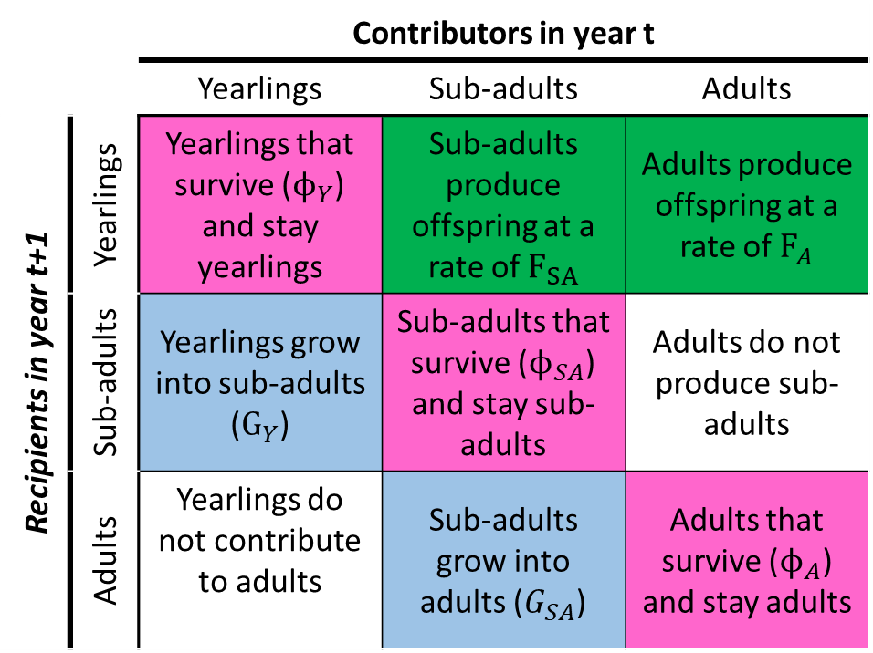

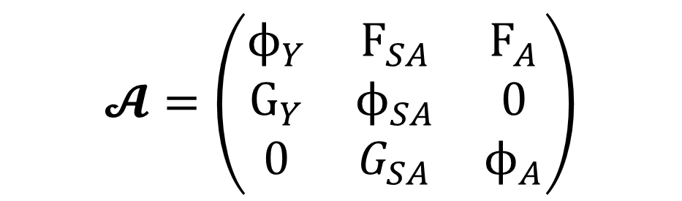
How to read the matrix $𝓐$
 |  | Contributors in year t
 |  | Yearlings | Sub-adults | Adults
Recipients in year t+1 | Yearlings | Yearlings that survive ($ϕ_{Y}$) and stay yearlings | Sub-adults produce offspring at a rate of $F_{SA}$ | Adults produce offspring at a rate of $F_{A}$
 | Sub-adults | Yearlings grow into sub-adults ($G_{Y}$) | Sub-adults that survive ($ϕ_{SA}$) and stay sub-adults | Adults do not produce sub-adults
 | Adults | Yearlings do not contribute to adults | Sub-adults grow into adults ($G_{SA}$) | Adults that survive ($ϕ_{A}$) and stay adults
$$𝓐=\left(\begin{matrix}ϕ_{Y} & F_{SA} & F_{A} \\ G_{Y} & ϕ_{SA} & 0 \\ 0 & G_{SA} & ϕ_{A}\end{matrix}\right)$$

Slide 9

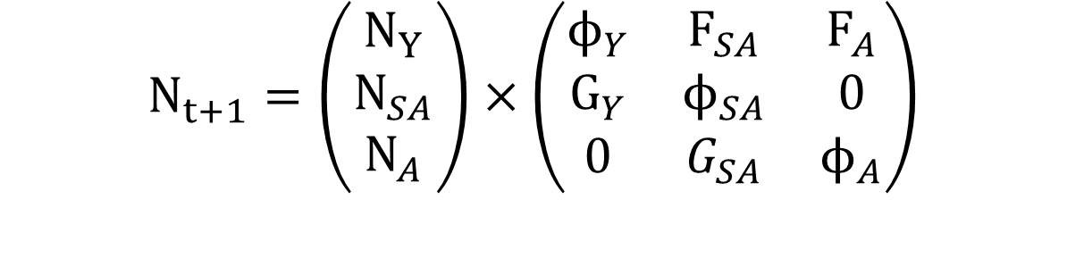
Otherwise, business as usual
 |  |  |  |  | $$N_{Stage,t}$$
$$G_{Stage}$$ |  | $$ϕ_{Stage}$$ | $$F_{Stage}$$ | Stage | 2008 | 2009 | 2010 | 2011
0.23 |  | 0.31 | 0 | Yearling | 26 | 28 | 29 | 27
0.26 |  | 0.42 | 0.4 | Sub-adult | 16 | 24 | 15 | 16
0 |  | 0.59 | 2.1 | Adult | 12 | 11 | 10 | 10
 |  |  |  | Total | 54 | 53 | 54 | 53
$$N_{t+1}=\left(\begin{matrix}N_{Y} \\ N_{SA} \\ N_{A}\end{matrix}\right)×\left(\begin{matrix}ϕ_{Y} & F_{SA} & F_{A} \\ G_{Y} & ϕ_{SA} & 0 \\ 0 & G_{SA} & ϕ_{A}\end{matrix}\right)$$

Slide 10
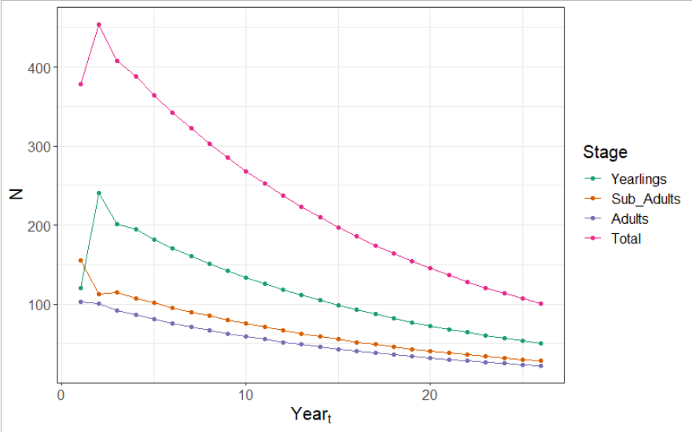
With the end result being;

Slide 11
What about when we have pseudo stages?
Leslie matrix models

Slide 12



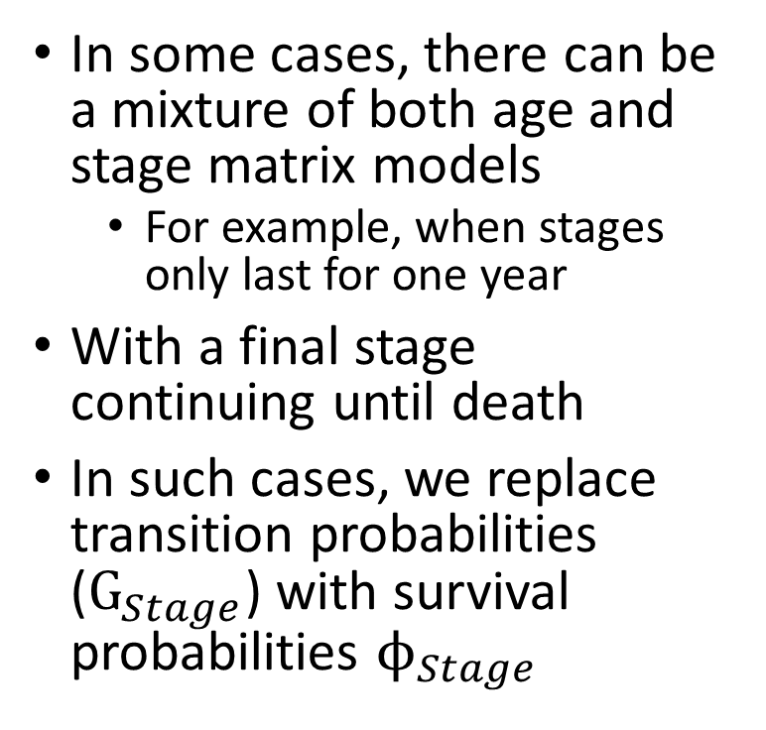






Stages with known time?
$$F_{SA}$$
$$F_{A}$$
In some cases, there can be a mixture of both age and stage matrix models
For example, when stages only last for one year
With a final stage continuing until death
In such cases, we replace transition probabilities ($G_{Stage}$) with survival probabilities $ϕ_{Stage}$
Y
SA
A
$$G_{Y}$$
$$G_{SA}$$
$$ϕ_{Y}$$
$$ϕ_{SA}$$
$$ϕ_{A}$$
$$F_{SA}$$
$$F_{A}$$
1
2
A
$$ϕ_{Y}$$
$$ϕ_{SA}$$
$$ϕ_{A}$$

Slide 13
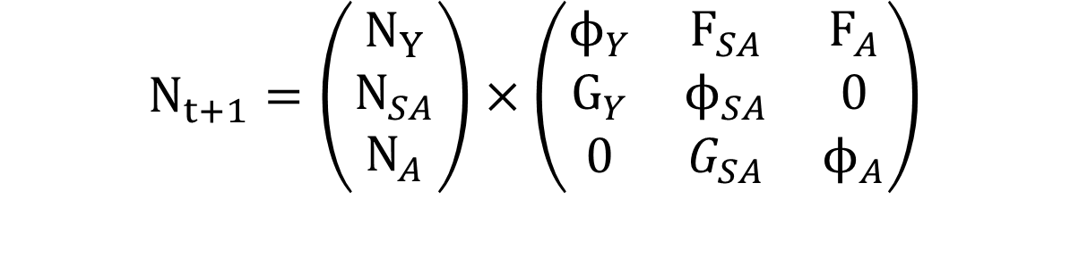
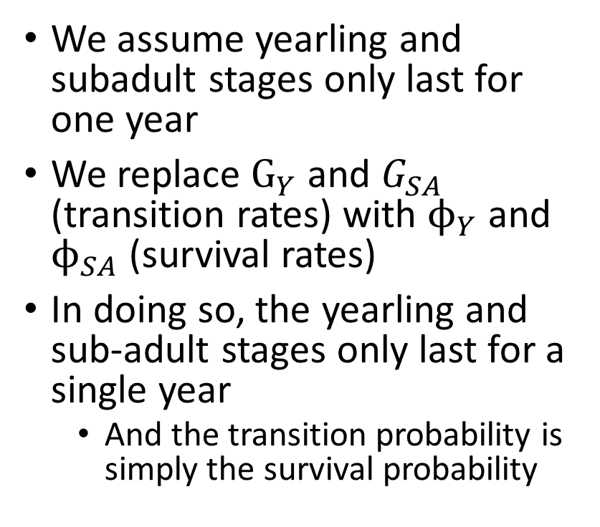
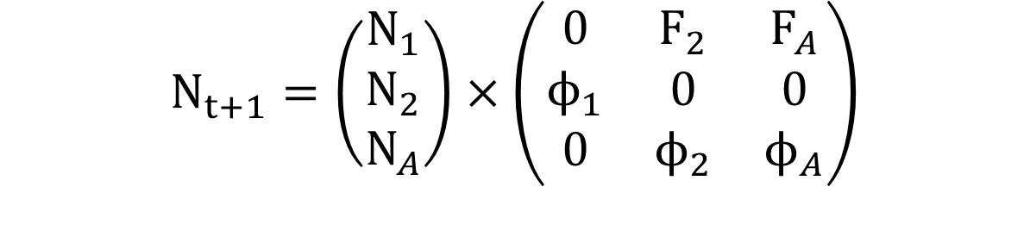
A simplification this time
We assume yearling and subadult stages only last for one year
We replace $G_{Y}$ and $G_{SA}$ (transition rates) with $ϕ_{Y}$ and $ϕ_{SA}$ (survival rates)
In doing so, the yearling and sub-adult stages only last for a single year
And the transition probability is simply the survival probability
$$N_{t+1}=\left(\begin{matrix}N_{Y} \\ N_{SA} \\ N_{A}\end{matrix}\right)×\left(\begin{matrix}ϕ_{Y} & F_{SA} & F_{A} \\ G_{Y} & ϕ_{SA} & 0 \\ 0 & G_{SA} & ϕ_{A}\end{matrix}\right)$$
$$N_{t+1}=\left(\begin{matrix}N_{1} \\ N_{2} \\ N_{A}\end{matrix}\right)×\left(\begin{matrix}0 & F_{2} & F_{A} \\ ϕ_{1} & 0 & 0 \\ 0 & ϕ_{2} & ϕ_{A}\end{matrix}\right)$$

Slide 14
Matrix eigenvalues
Very powerful information hidden with matrices
3 eigenvalues

Slide 15
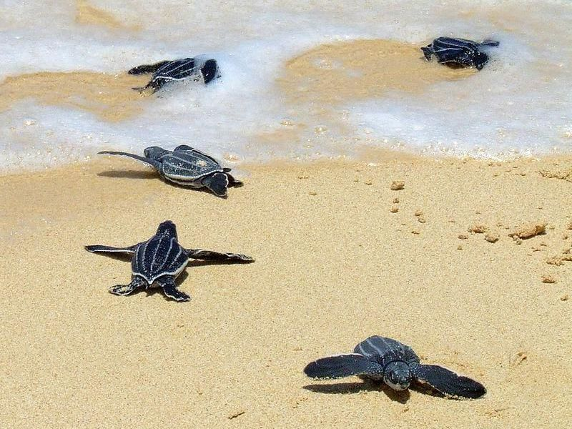
Eigenvalues
Properties of the matrix
(Any matrix has these values)
In biological context, incredibly useful
What is our population growth rate?
What is the age structure of our population?
Which stage is most important for growth?
We won’t go into the maths behind them

Slide 16
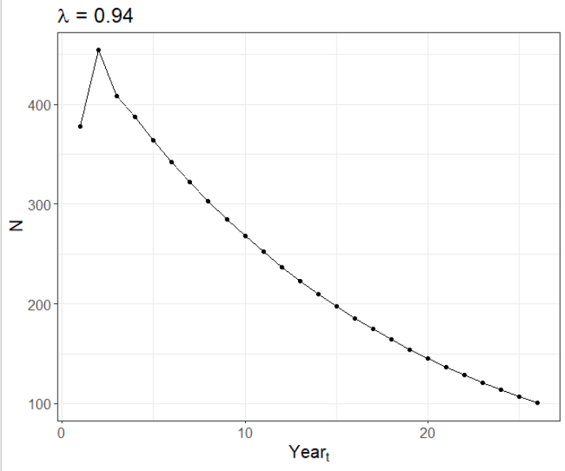
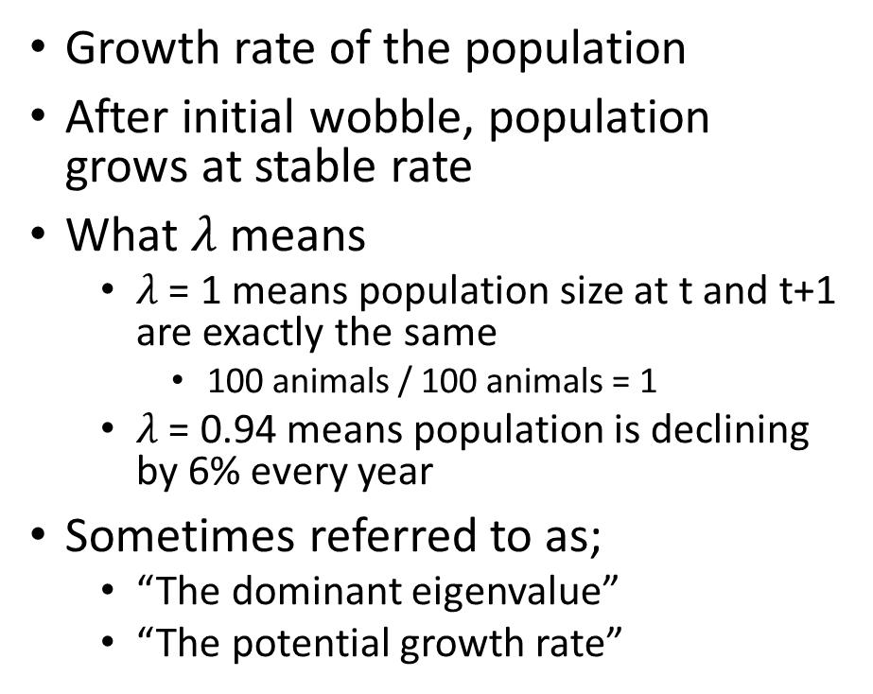

1. Lambda ($λ$)
Growth rate of the population
After initial wobble, population grows at stable rate
What $λ$ means
$λ$ = 1 means population size at t and t+1 are exactly the same
100 animals / 100 animals = 1
$λ$ = 0.94 means population is declining by 6% every year
Sometimes referred to as;
“The dominant eigenvalue”
“The potential growth rate”

Slide 17
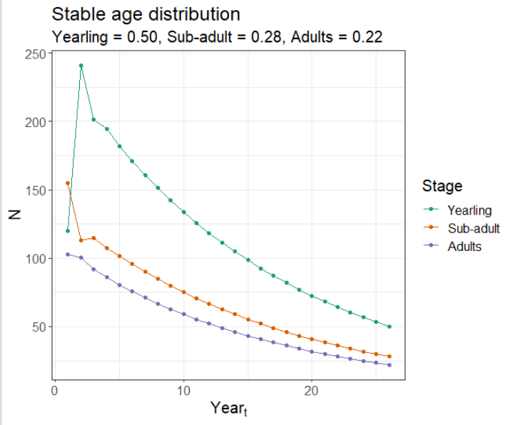
2. Stable age distribution (ss)
Once population has stabilised, each age/stage will be at constant proportions
Allows you to say;
“22% of our population are adults”
Cause of initial wobble in N
Takes time to reach stable age distribution
Based on proportion of initial population
Sometimes referred to as;
“The right eigenvector”
“The dampening ratio”

Slide 18
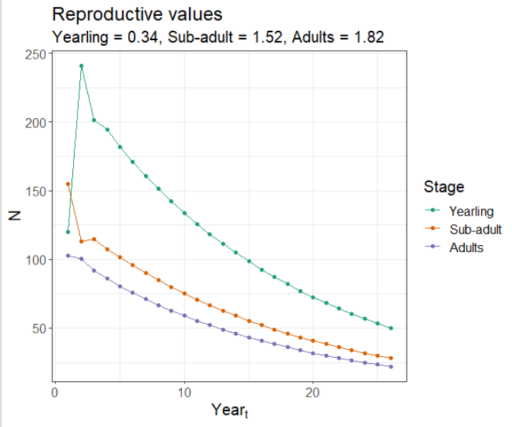
3. Reproductive value (rv)
The reproductive value represents an age/stage’s relative contribution to future population growth
Higher reproductive values reflect stages/ages of more conservation importance
E.g. focus efforts on adults (1.82) rather than yearlings (0.34)
Sometimes referred to as;
“The left eigenvector”

Slide 19
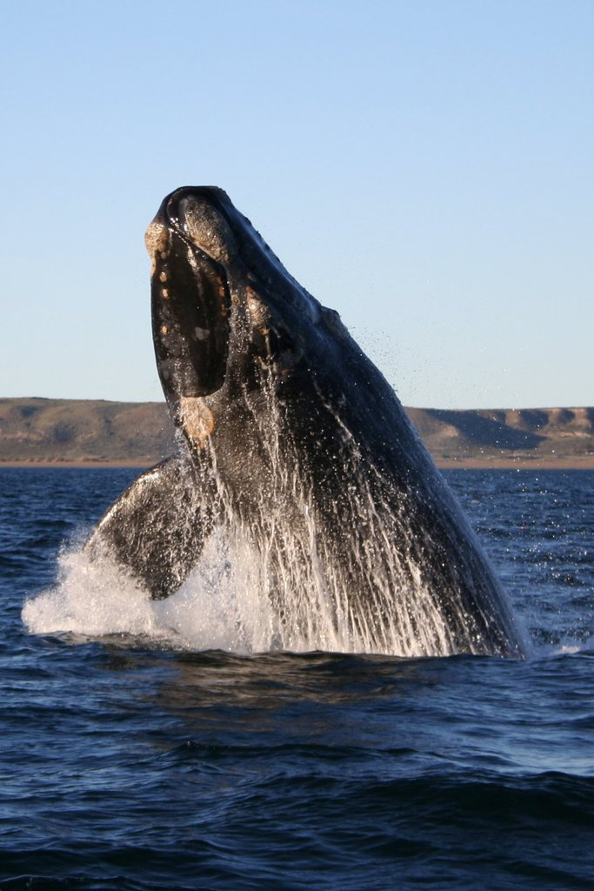
Sensitivities and Elasticities
Not all age/stages are equally important to population growth
Not all rates are equally important to population growth
Changing adult survival by 10% can have a much larger impact on the population than changing yearling survival by 10%

Slide 20
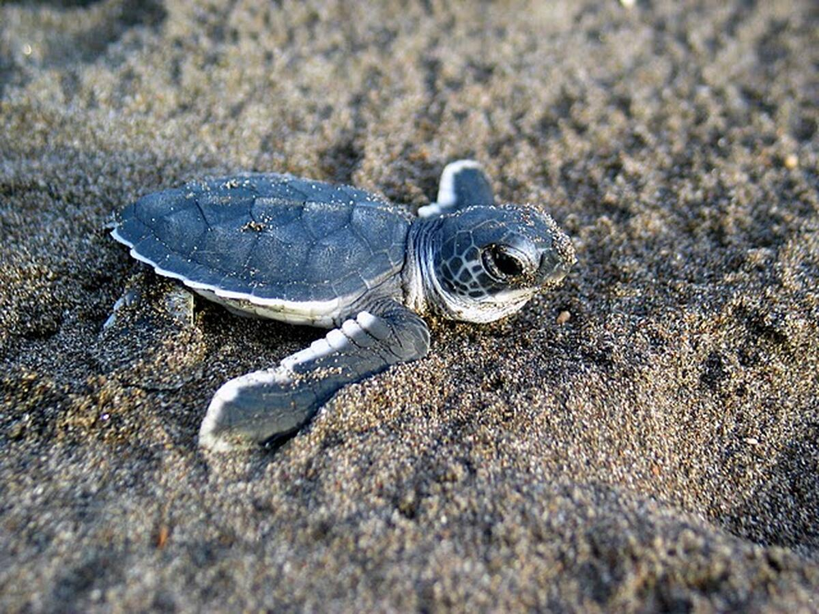
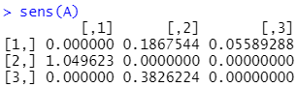
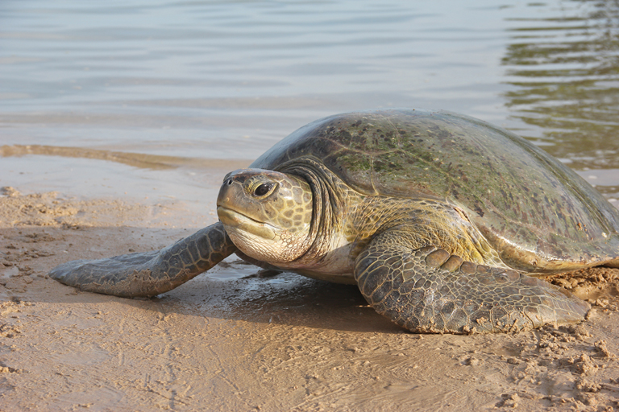
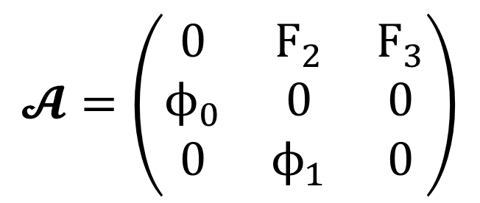
Sensitivity
$$𝓐=\left(\begin{matrix}0 & F_{2} & F_{3} \\ ϕ_{0} & 0 & 0 \\ 0 & ϕ_{1} & 0\end{matrix}\right)$$
Within the matrix, which parameters are more sensitive to being “poked”
Reports a matrix with the same structure as our initial matrix
The higher the value, the more sensitive to change
But is scale dependent!
Can’t easily compare rates

Slide 21
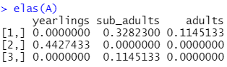
Elasticity
$$𝓐=\left(\begin{matrix}0 & F_{2} & F_{3} \\ ϕ_{0} & 0 & 0 \\ 0 & ϕ_{1} & 0\end{matrix}\right)$$
“What is the effect of a proportional change in a rate?”
Reports a matrix with the same structure as our initial matrix
Is scale independent!
Can easily compare rates

Slide 22
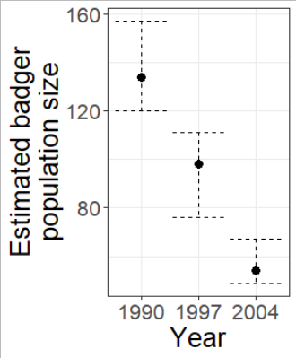
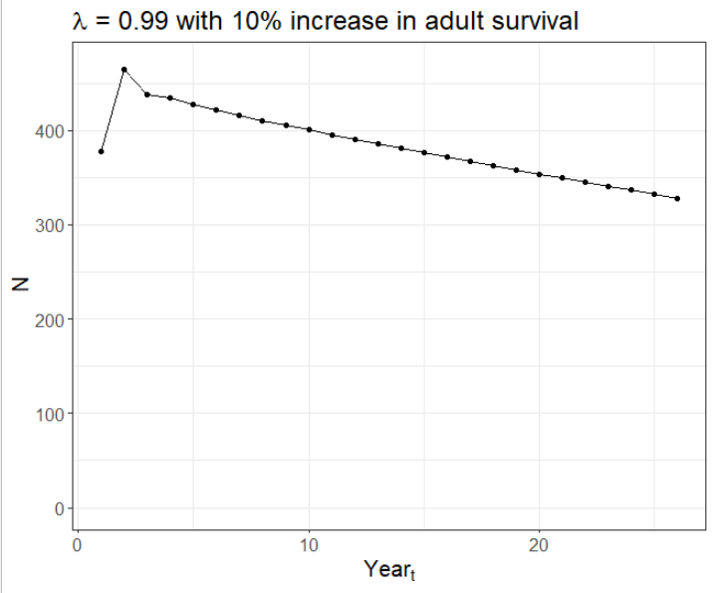
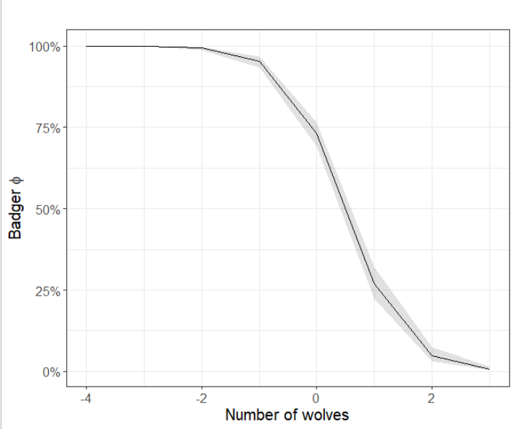
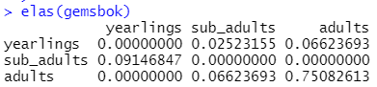
Projecting conservation interventions
Identify problem
Badgers declining
Identify cause
Wolves kill badgers
Predict population trend
Declining at 6%
Identify vital rate to manage
Adult survival
Test hypothetical intervention
Increase adult survival by 10%
Update adaptive management plan

